Slide 1
Outlawed Faith (aka Renegade)
The Forge Studios

Slide 2
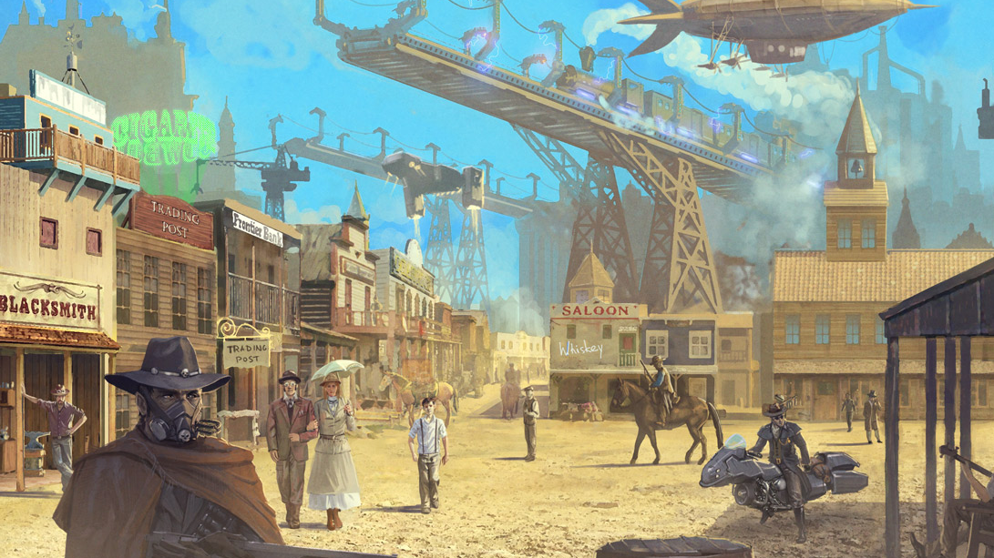
Synopsis: (Steampunk/Western/Sci-Fi)
In a dystopian universe, on a dead-end, backwater world, an orphaned boy and his sister, a mystic Seer, try to escape from the sway of their megalomaniac uncle by seeking out the help of a reformed gunslinger.
Outlawed Faith is an action adventure science fiction which brings forward an unlikely and reluctant hero to save these. Bringing together a mashup of genres (Steampunk/ Western/Sci-fi) creates the perfect blend of genres to create the largest audience appeal.
Steampunk is an explosive genre still open to full exploration in novels and films.
The story takes a nod at the ever-loved Firefly franchise and serves those whom still crave more of that saga.
Young Jonah's faith carries him and his young sister, Celine, to the last borderland town, Harpdale, in order to escape captivity. They seek out his mother's old friend, the famous reformed gunslinger Kulta; but what they find is more than what anyone bargains for.

Slide 3
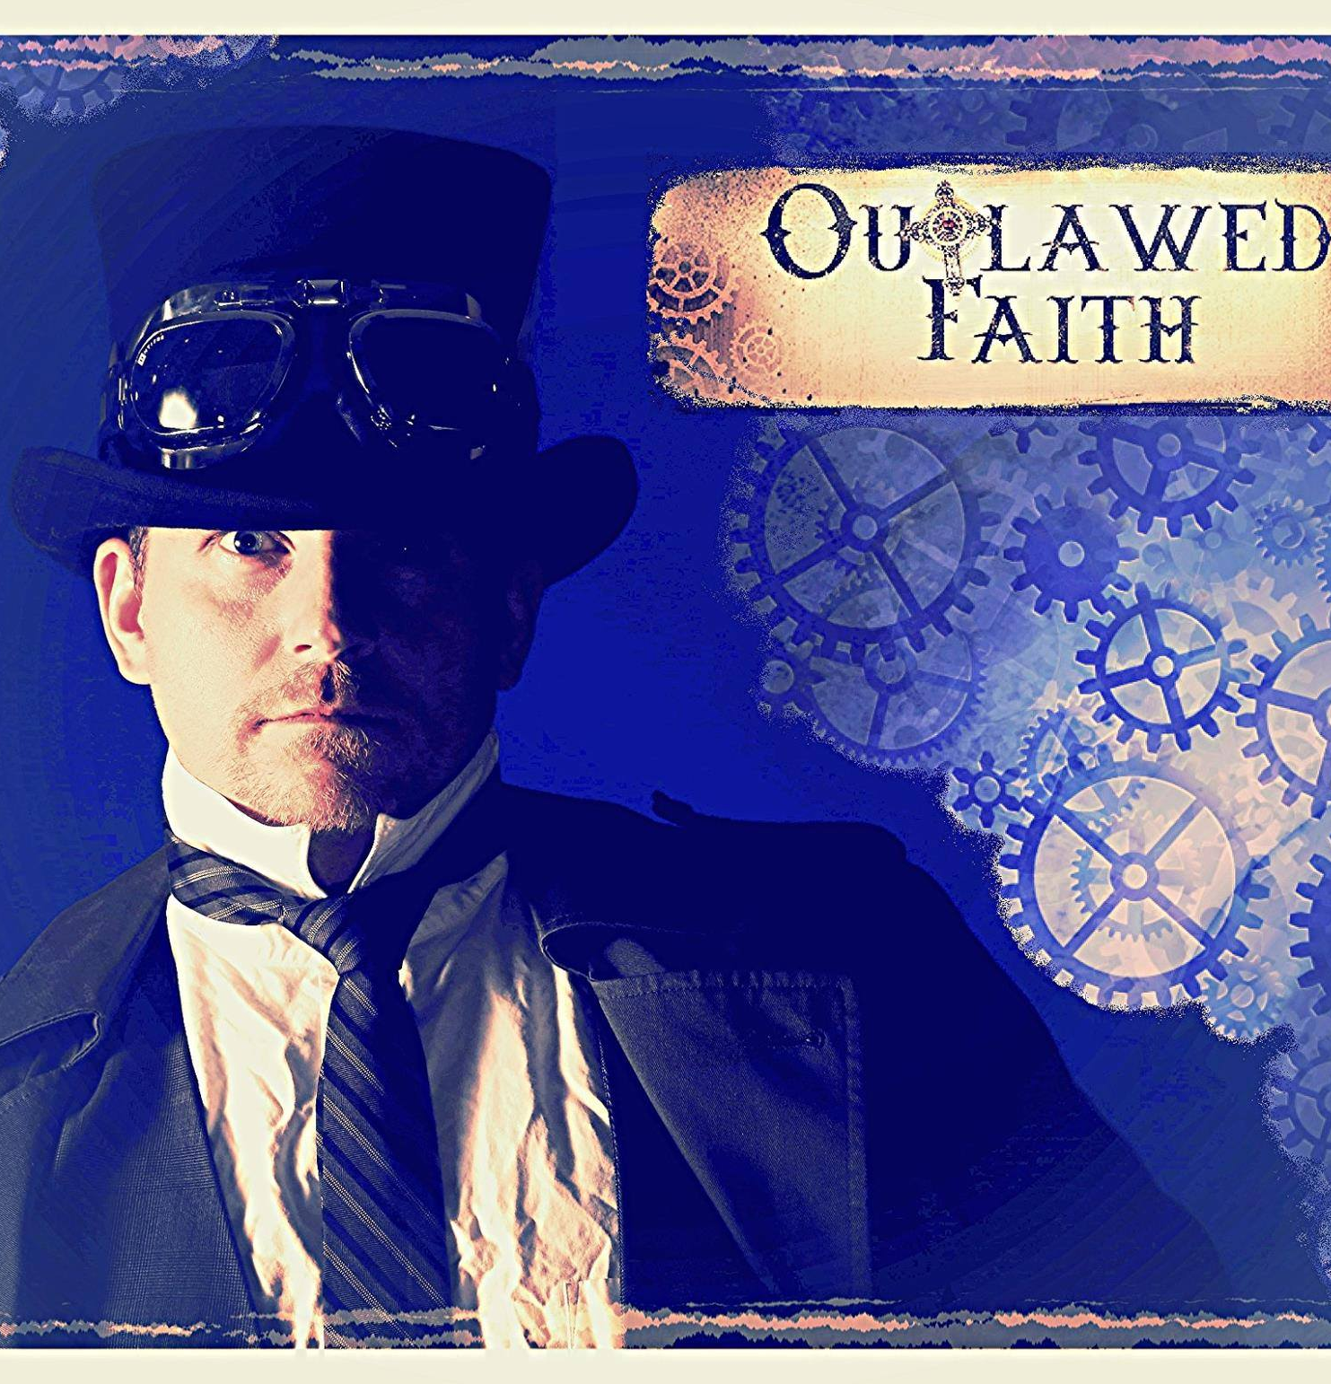
Creator/Director
Ron Newcomb
The accomplished storytelling of award winning Producer/Director of “Rise of The Fellowship” & “Made in the USA” (documentary), Ron Newcomb has the creative vision to create something new and fresh. His prior military (USMC) and law enforcement background make him a perfect candidate to tell this epic tale.
Mentors Available:
Mark Ordesky – Lord of the Rings; Producer, The Quest; EP
Gilbert Adler – Superman Returns, Valkyrie; Producer
Ralph Winter – X-Men; Producer
Dean Batalli – Buffy the Vampire Slayer, That 70’s Show
Reel: https://youtu.be/ihD8zxjpCAg

Slide 4
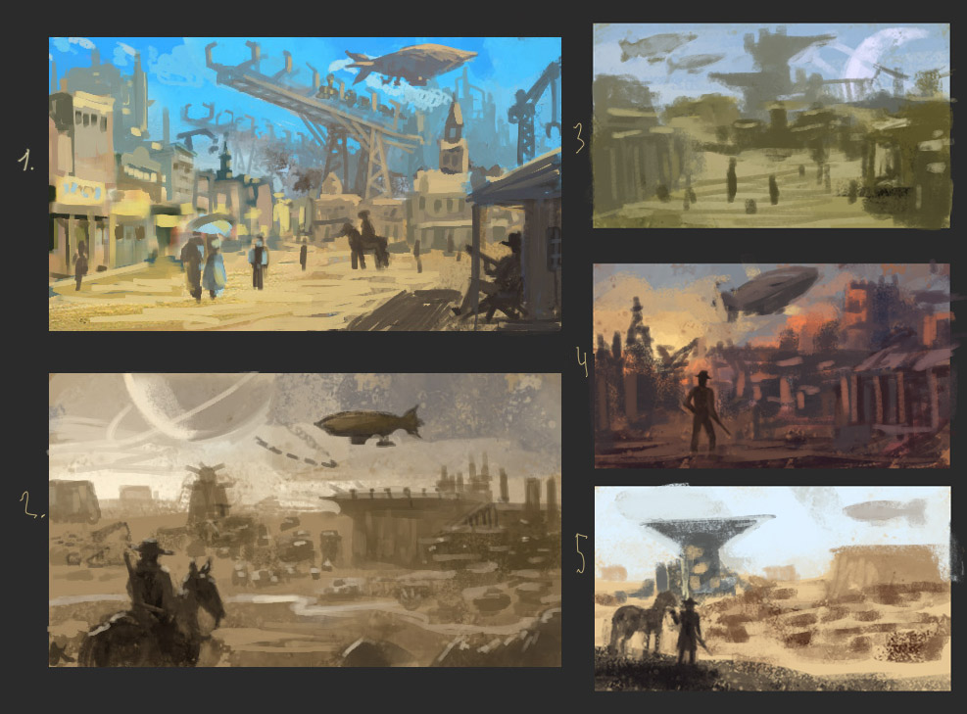
“Proof-of-Concept”
The Forge Studios generates shorts that are approximately 9 to 12 minutes long, allowing us to demonstrate our craft and our content before committing to a full-length feature or pilot. This allows us to explore all distribution options and take the most lucrative option available. The proof-of-concept short for Outlawed Faith was funded through a successful Kickstarter Campaign.
The short has been seen over 300,000 times on Facebook: https://www.facebook.com/theforgestudios/videos/1032897660142370/

Slide 5
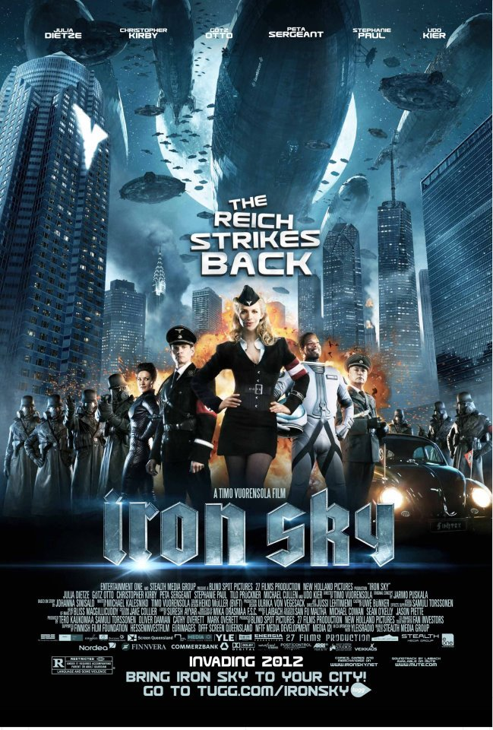
Character Profiles
KULTA: is a free trader/smuggler and the pilot of the Deus Ex Mechina, has a checkered past, one that he would rather forget, as a hired gun and enforcer for the Klinkertons.
LEVI: is young, but has been Kulta’s co-pilot for some time; as fast with his gun as he is with his wit, he is dedicated to Kulta at all cost. Games of chance call to him.
BARNIBAS: is the prefect from the planet, Alpha Prime, that he rules by his band of guns, the Klinkertons. He’s the uncle of Celine, the mystic seer.
CELINE: a young girl that does not know her destiny, but was gifted with unique powers and is known as a seer.
JASPER: a flamboyant ruler of the off-world space station, The Cove.
SARAH: a believer in the old faith of the seers and a watcher.
FINX: a cat-like alien hunter from the Galactic Federation
The GALATIC FEDERATIONI, ruler of known galaxies. Dressed in Diesel-Punk attire (think Iron Sky).

Slide 6
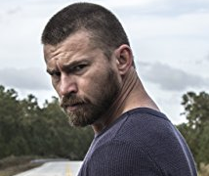
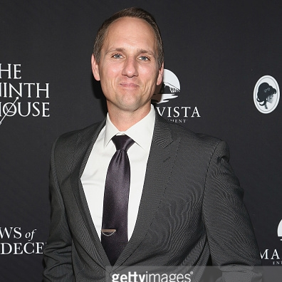
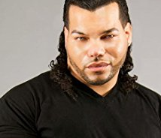
Known Talent
Ron has a personal relationship with each of these actors…
William Mark HERE; 11,000 on Instagram
Jim Klock HERE; 31,000 on Twitter
Erin Cahill HERE; 50,000 on Facebook
Lyon Beckwith HERE; 3,800 on Instagram

Slide 7
Target audience – “The Tribe”
The “Dungeons and Dragons” generation has grown up and gone global while spreading the interest to Gen Y and MillennialsUnderstanding this fan-base and how to market to them is a core competency for the team at The Forge Studios and Outlawed Faith is targeted to this particular niche -- the coveted 14-24 year old moviegoing, game playing audience.
These fans consider themselves part of a “Tribe” and crave active participation in the fantasy/sci-fi world. An even audience of men and women, they dress up in costume, participate in Live-Action-Role-Play (LARP) games, or create their own “fan films” based on series, movies or graphic novels. These fans crave the exact characters and storylines in Outlawed Faith. The fan base for this film includes enthusiastic participants in Comic-Con in San Diego, GenCon, Massive Multiplayer Online (MMO) game enthusiasts (between 8 and 20 million users worldwide), Renaissance Fairs (US & Canada), Medieval Festivals (Europe), worldwide members of The SCA (Society for Creative Anachronisms) and LARP (Live Action Role Playing).

Slide 8
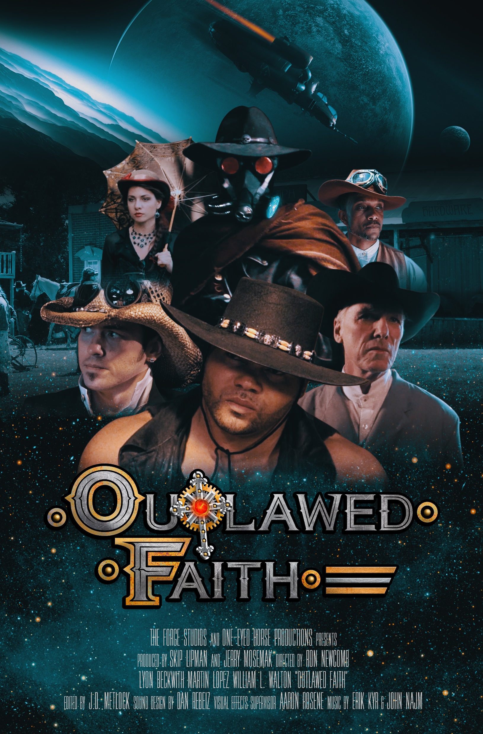
Potential Production Partners
Galatia Films
#1 Documentary on iTunes “Reclaiming the Blade” for several months after launch.
Arrowstorm Entertainment
New series on The CW “The Outpost”
The Slice of Life

